Slide 1
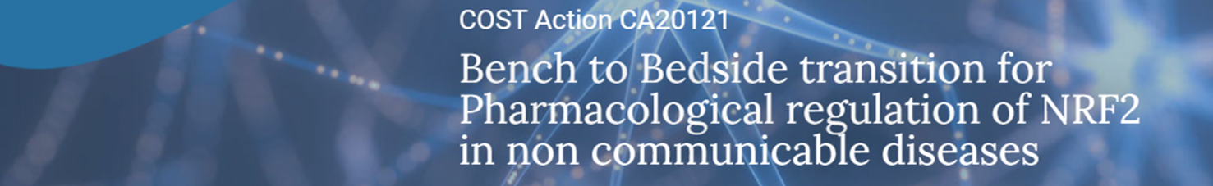









Building bridges between
academia and industry
WG4
Company | Contact person | Email and web | scientific field | Pathologies of interest
Spain | Antonio Cuadrado | https://servatrix.eu | Targeting NRF2 in NASH | non-alcoholic steatohepatitis (MASH) and its progression towards liver fibrosis and cirrhosis
Greece | Ioannis Trougakos | itrougakos@biol.uoa.gr http://scholar.uoa.gr/itrougakos/home | Specializes in the field of systems biology with a primary focus on combating ageing and age-related diseases. | Ageing and age-related diseases
Germany | Juergen Eckel | juergen.eckel@curediab.de | CureDiab has identified thioacrylamide-derivatives (HK1,3,4) that mediate activation of peripheral GABA-A receptors resulting in hepatoprotection, reduction of steatosis and an anti-fibrotic response. | Non-alcoholic steatohepatitis (MASH) Therapy
Spain | Ángel Juan García-Yagüe | ajgarcia@iib.uam.es | 6-MSITC regulates p-TAU levels through an independent mechanism of NRF2 action. These mechanisms also are independent through signaling pathways that regulate GSK-3β activity | Alzheimer’s disease (AD)
France | Philippe Delerive | philippe.delerive@nestle.com | Novel and selective molecule able to disrupt the KEAP1-NRF2 interaction | Non-alcoholic steatohepatitis (MASH) Therapy
Austria | Vanja Nagy Neuroscience Program Director | www.cebina.eu and www.danubeneuro.com vanja.nagy@cebina.eu | Central European Biotech Incubator and Accelerator
Netherlands | Jed W. Fahey | jedosan@gmail.com | Their interest draws on elements of natural product chemistry, enzymology, nutritional epidemiology and clinical research to develop nutritional strategies, may be available to consult for socially responsible food and supplement companies and foundations | Chronic disease
USA | Raymond. K. Houck CEO. Aclipse Therapeutics | rhouck@aclipsetherapeutics.com https://aclipsetherapeutics.com/ | M102, a combined Nrf2 and HSF1 activator for the treatment of Amyotrophic Lateral Sclerosis and other neurogenerative diseases | Amyotrophic Lateral Sclerosis
USA | Deborah Ferguson | https://www.biogen.com deborah.ferguson@biogen.com | Omaveloxolone has been shown to increase Nrf2 activity and improved neurological function as assessed by modified Friedreich ataxia rating scale (mFARS) scores. FDA approval in 2023 | Friedreich ataxia

Slide 2



Building bridges between
academia and industry
WG4
Company | Contact person | Email and telephone number | scientific field | Pathologies of interest
 | Nil Roy
 | Keith Ward | keith.ward@kuriatx.com
USA | Anil Goyal | anil@immventionthera.com https://vtvtherapeutics.com/pipeline/ | Nrf2 activation induced by Bach1 inhibitors | Chronic Kidney diseases
 | Harry Van Goor | h.van.goor@umcg.nl | Use of Thiosulfate Treatment as a Modulator of NRF2: Effect in Cardiac Infarction Patients. | Cardiovascular deseases

