Slide 1
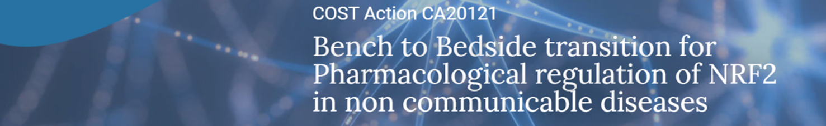
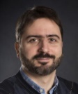
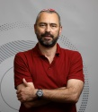
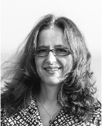
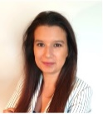
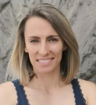
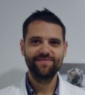
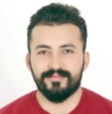
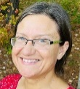
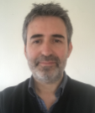
Building bridges between
academia and industry
WG4
Full name | Position and Institution | Email and telephone number | Expertise and the scientific field | Techniques, animal works or determinations for possible collaborations
Gerasimos SYKIOTIS | Associate Professor and Senior Staff Physician, Lausanne University Hospital, Switzerland | gerasimos.sykiotis@ chuv.ch +41 213140606 | Internal medicine, Endocrinology, Metabolism, Autoimmunity, Thyroid diseases, Parathyroid diseases, Neuroendocrine tumors. | Patient samples and data, Nrf2 KO mice, Keap1 hypomorphic mice.
Arie Gruzman | Professor, Dept. of Chemistry, Bar-Ilan University, Ramat-Gan, Israel | gruzmaa@biu.ac.il +972-54-7489041 | Synthetic organic chemistry, Drug discovery, NRF2 activators | Synthetic organic chemistry
Albena T Dinkova- Kostova | Professor of Chemical Biology, University of Dundee School of Medicine, Dundee, United Kingdom | a.dinkovakostova@ dundee.ac.uk +44 1382 383386 | Interested in the chemistry and pharmacology of Nrf2 activators using cells and animal models. | Cell-based assays for screening of potential Nrf2 activators based on the enzyme activity of its prototypic target, NQO1 CETSA for target engagement of Keap1 in cell lysates, intact cells and animal tissues
Joana Loureiro | Auxiliary Researcher and Invited Assistant Professor Faculty of Engineering, University of Port Portugal | jasl@fe.up.pt +351910671344 | Production of biocompatible nanoparticles for drug delivery | Nanoparticles full characterization
Marisa Andreia Carvalho de Freitas | Researcher at REQUIMTE/Faculty of Pharmacy of University of Porto, Portugal | marisafreitas@ff.up.pt | Biological activities of polypehnols, namely their antioxidant, anti-inflammatory and anti-diabetic activities. | We have assays related with antioxidant/anti-inflammatory actvity: Considering the anti-diabetic activity:
Bruno Ramos- Molina | Group leader of the Obesity, Diabetes and Metabolism lab, Biomedical Research Institute of Murcia (IMIB) Spain | bruno.ramos@imib.es +34694447702 | Obesity and metabolic disorders. Significant expertise in grant writing, project coordination, and laboratory management. I am developing new biomarkers and establishing novel in vitro models derived from liver tissue of MASH patients for pharmacological testing. | Isolation, culture and differentiation of human liver organoids from MASLD/MASH patients. Pharmacological testing of candidate drugs in in vitro models of MASH and fibrosis, including human liver organoids, primary human hepatocytes, and human hepatocyte cell lines.
Murat Yılmaz | Assistant Professor Doctor/ Osmaniye Korkut Ata University Turkey | muratyilmaz@ osmaniye.edu.tr +905077532911 | I'm a chemical engineer. My research area is wastewater treatment, adsorption, activated carbon prıduction from biomass. Heavy metal, dye, drug removal. | We cannot carry out studies on living things in our laboratory. We work with chemicals.
Eugenia Carvalho | Principal Investigator Center for Neuroscience and Cell Biology University of Coimbra Portugal | ecarvalh@cnc.uc.pt (+351) 239 820 190 | Insulin action in cells and stromal vascular fraction; In vivo metabolism and immune metabolism. Mitochondrial OXPHOS in fresh tissues and cells. | Insulin signaling in isolated fresh primary adipocytes or explants (rodent/human); Mitochondrial OXPHOS; in vivo pre-clinical models of wound healing under diabetes conditions and/or infection.
Santiago Cuevas | Principal investigator Biomedical Research Institute of Murcia (IMIB) Murcia ( Spain) | santiago.cuevas@imib.es +34 868 885324 | Expertise in Nrf2/keap1 pathway and inflammasome NLRP3 activation and its role in the pathogenesis of renal diseases | Determine protective effects of new medication in animal models of diabetes and renal diseases including mice determinations of glomerular filtration rate. Innovative method to determine inflammasome NLRP3 activity in cell culture, animal models, and humans.

Slide 2
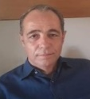
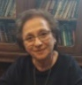
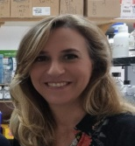
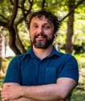
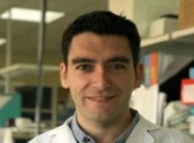
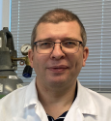

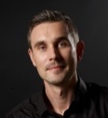
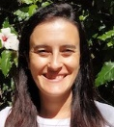
Building bridges between
academia and industry
WG4
Full name | Position and Institution | Email and telephone number | Expertise and the scientific field | Techniques, animal works or determinations for possible collaborations
Ioannis Trougakos | Professor The National and Kapodistrian University of Athens, Greece | itrougakos@ biol.uoa.gr +30 6944 674040 | We focus on studying the molecular and cellular mechanisms that underly aging and age-related diseases. More specifically, we investigate the role of several components that constitute the proteostasis network (PN) under normal or pathological conditions.. | Cellular-molecular biology and analytical biochemistry assays, along with a diverse array of advanced bio-imaging techniques and high throughput transcriptome and proteome analysis assays. Cell-based and in vivo models; extended bio-bank of human/mice normal or cancer cell lines, along with a large collection of transgenic Drosophila lines and also transgenic mice lines developed by us (http://scholar.uoa.gr/itrougakos).
Gina manda | Principal Investigator Victor Babes National Institute of Pathology Bucharest, Romania | gina.manda@ gmail.com +40744246887 | Cellular biology and immunology | Cell cultures, flow cytometry, qRT-PCR
Isabel Lastres- Becker | Associate Professor at Universidad Autónoma de Madrid Spain | ilbecker@iib.uam.es +34915854449 | Mechanisms and biomarkers in neurodegenerative diseases to stablish new therapeutic strategies. We are focused on Parkinson's disease, Alzheimer's disease, Frontotemporal Dementia and ALS. | Use of cell lines from patients with these neurodegenerative diseases (fibroblasts, iPSC and neuron/astrocytes derived from iPSC). We also have immortalized mouse or human lines to overexpress proteins involved in these diseases. Murine models of PD, FTD based on AAV inoculation.
Srđan Bjedov | Assistant Professor at the Department of Chemistry, Biochemistry and Environmental Protection, Faculty of Sciences, University of Novi Sad, Serbia | srdjan.bjedov@ dh.uns.ac.rs, +381637120138 | Synthetic and medicinal chemistry, particularly in the development of various enzyme modulators. We possess the know-how and equipment necessary for synthesizing small molecule Nrf2 modulators. | Organic synthesis, structure elucidation
Juan Antonio Moreno | Principal Investigator, Group of Pathophysiology of renal and vascular damage. Maimonides Institute for Biomedical Research of Cordoba, Spain. University of Cordoba, Spain. | juan.moreno@uco.es +34 661420756 | Novel pathogenic mechanisms involved in the development of renal and cardiovascular diseases. Identifying new molecules involved in the progression of these pathologies that may be used as prognostic biomarkers and therapeutic targets. | We have experience in cellular studies and development of animal models of multiple pathologies, including atherosclerosis, diabetic nephropathy, glomerular diseases, acute kidney injury, renal fibrosis, among others. We could perform in vitro and in vivo studies in mice to determine wheter a compound may protect against oxidation, inflammation, apoptosis, fibrosis, etc.
Anton Terasmaa | Senior researcher, national Institute of chemical and biological physics Estonia | anton.terasmaa@ kbfi.ee +37256925074 | Rare diseases, animal models of rare disease, in vitro models | In vitro work only
Fernando Antunes | Full Professor, University of Lisbon, Faculty of Sciences Portugal | fantunes@fc.ul.pt +351 96 0289194 | 1- Systems biology applications, namely kinetic modeling of redox biological systems; 2- Measuring metabolic fitness with direct calorimetry. | Heat dissipation (direct calorimetry); hydrogen peroxide (electrochemistry); Human peripheral blood mononuclear cells
Anders Bach | Professor, University of Copenhagen Denmark | anders.bach@ sund.ku.dk | I am an expert in medicinal chemistry and have in the last 8 years worked on non-covalent Keap1-Nrf2 inhibitors using fragment-based drug discovery. | Medicinal chemistry, drug design, molecular docking, X-ray crystallography, surface plasmon resonance, fluoresence polarization, fragment-based drug discovery - of compounds targeting the Kelch domain of Keap1.
Vera Marisa Costa | Researcher at Faculty of Pharmacy University Porto Portugal | veramcosta@ff.up.pt +00351963264831 | Adverse effect of anticancer drugs: Cardio-oncology and chemobrain. Toxicity of toxins and drugs of abuse | Cell culture experience in several cell lines Felasa C Creditation to work with laboratory animal models Oxidative stress measurements and OMICs methods

Slide 3
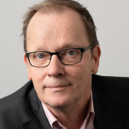
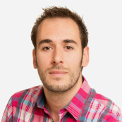
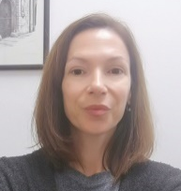
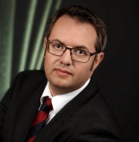
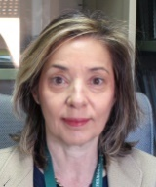
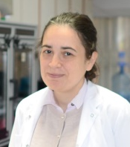
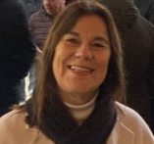
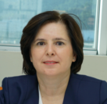
Building bridges between
academia and industry
WG4
Full name | Position and Institution | Email and telephone number | Expertise and the scientific field | Techniques, animal works or determinations for possible collaborations
Harry Van Goor | Professor in experimental nephropathology, University Medical Center Groningen, The Netherlands | h.van.goor@umcg.nl 0031-641194350 | Development of drugs, pathology, mitochondrial function, biomarkers. Oxidative stress biomarkers, drug development for CVD, mitochondria-NRF2 interactions. | Immunohistochemistry, spatial transcriptomics, mitochondrial dynamics, experimental models, clinical cohorts
Laureno De la Vega | Senior Lecturer, University of Dundee Scotland United Kindon | l.delavega@ dundee.ac.uk +44(0)1382 383990 | BACH1 and NRF2 biology. Identification and characterisation of BACH1 inhibitors and dual BACH1/KEAP1 inhibitors. | Optimised cell-based high throughput screening to identify BACH1 inhibitors and dual BACH1/KEAP1 inhibitors. Pipeline from screening to validation in several cell models. Identification of mechanism of action. Large panel of human and mouse cell lines with BACH1 and/or NRF2 knockouts Lung and breast cancer models: Xenograft and syngrafts Validated protocols to study BACH1 in human tissue by IHC
Lidija Milkovic | Senior Research Associate at Rudjer Boskovic Institute Division of Molecular Medicine Zaged, Croatia | lidija.milkovic@irb.hr +38514571212 | Oxidative stress and lipid peroxidation in various health conditions, particularly cancer. Reactive oxygen species (ROS), produced during oxidative stress, play a role in cellular outcomes, dependent on their concentration and type. I am particularly interested in the interplay between oxidative stress, antioxidative mechanisms (especially NRF2), and metabolic alterations in cancer. | My expertise involves working with different cell cultures and includes all techniques that evaluate cell growth (cell viability and cell proliferation assays, migration, sphere formation), monitoring apoptosis (FACS), ROS formation, together with the western blot analyses, PCR analyses, ELISA assays.
Harald Sourij | Professor for Interdisciplinary Metabolic Medicine, Head of the Trials Unit for Interdisciplinary Metabolic Medicine, Medical University of Graz, Austria | ha.sourij@medunigraz.at +43 316 385 81310 | Mono- and multicentric clinical trials in the field of diabetes, lipids and cardiovascular disease. Trial execution, regulatory submissions, trial design, data management, biostatistics and monitoring activities. | Design and execution of clinical trials.
Angela Martinez Valverde | Senior Staff Scientist. Instituto de Investigaciones Biomédicas Sols-Morreale (CSIC-UAM). Centro de Investigación Biomédica en Red de Diabetes y Enfermedades Metabólicas Asociadas (CIBERdem), Madrid, Spain. | avalverde@iib.uam.es Tel +34 91 5854497 | Molecular basis and pharmacologycal treatment of obesity and comorbidities including insulin resistance, type to diabetes and metabolic fatty liver disease | Metabolic phenotyping (glucose, insulin and pyruvate tolerance tests, glucose-stimulated insulin secretion) Primary cultures of hepatocytes, Kupffer cells, macrophages (bone marrow-derived), brown adipocytes, subcutábeous white adipocytes and pancreatic islets
Serap Evran | Professor, Ege University Turkey | serap.evran@ ege.edu.tr +902323112304 | Experienced in biochemistry and recombinant DNA technology. We can offer expertise in the field of cloning, recombinant protein production in E. coli. cells, and analysis of protein-protein interactions. | Cloning, recombinant protein production in E. coli cells, DNA aptamer selection for diagnostic and therapeutic purposes.
Maria Teresa Cruz | Group Leader at Centre for Innovative Biomedicine and Biotechnology (CIBB) Associate Professor at the Faculty of Pharmacy, University of Coimbra, Portugal | trosete@ff.uc.pt | Development of new Nrf2 activators for neurodegenerative diseases. We identified, for the first time, a new small-molecule activator of the transcription factor Nrf2 with promising results in in vitro and in vivo models of Alzheimer’s disease. | We use sub-cellular fractions, cell lines, primary cell cultures, mice and human samples as experimental models for the study of inflammatory and neurodegenerative diseases
Sermin Genc | PI-Prof. Dr. Izmir Biomedicine and Genome Center Turkey | sermin.genc@ ibg.edu.tr 90.232.2994100 | Our studies focus on neurodegeneration and neuroprotection | From cell culture studies to clinical biomarker studies

