Slide 1


Benbedphar
COST Action CA20121
Bench to bedside transition for pharmacological regulation of NRF2 in noncommunicable diseases
Brigitta Buttari, Italy (WG5 Leader)
Department of Cardiovascular, Endocrine-Metabolic Diseases and Aging
Istituto Superiore di Sanità - Roma
“Research and therapeutic tools in the field of NRF2 medicine”
“Victor Babes” National Institute of Pathology, Bucharest, Romania
13-14 October, 2022
Notes:
Good morning to all. I briefly introduce my self: my name is Brigitta Buttari I coordinate the WG5 in collaboration with Ana Rita Carlos under the supervision of prof. Cuadraso and prof Gina Manda. Here I will briefly summarize the data on the Webinars and I want also to discuss with the audience our plans for the next year and our To do list

Slide 2
2. Identification of relevant social networks and events for promoting NRF2-related medicine and limitations in the lay public
On March 3, 2022 has been started the webinar series. Webinars are organized in collaboration with the Prof. Luciano Saso, Sapienza University of Rome and Brigitta Buttari in the REDOX WEBINAR SERIES "Oxidative Stress: Biochemical and Pharmacological Aspects" on https://antiox.it platform. This webinar series is open to the scientific community and lay audiences and is free of charge.
Notes:
Webinars are one of the main tasks reported for WG5 for promoting NRF2-related medicine to the scientific community and lay audiences. Webinar represents a successful tool to disseminate knowledge in EU-funded projects. PRODUCING AND HOSTING A SUCCESSFUL WEBINAR, it doesn't have to be difficult but it requires that few simple steps have to make for a successful event. When a webinar production is scheduled , the topic, the speakers and the date are setted. Moreover, a Plan B has been made in case a speaker gets sick or a producer has a family emergency.

Slide 3
Deliverables: D5.1 Project-dedicated webpage (www.benbedphar.eu) & Updates
Three webinars have been posted on the “Events” section of BenBedPhar webpage as webinar.
Recorded webinars are always available on website https://www.antiox.it/.

Slide 4
Deliverables: D5.2 Reports on participation in social media and other events (including the number of accessions)
Three webinars in REDOX WEBINAR SERIES have been organized on https://antiox.it platform. In the first webinar related to NRF2 and Cancer, three lectures have been given and it had worldwide participants (383 registrations and about 210 participants). In the 2nd webinar related to NRF2 and vascular diseases three lectures has been given and it had worldwide participants (183 registrations and about 100 participants). In the 3rd webinar related to NRF2 and metabolic diseases, three lectures has been given and it had worldwide participants (203 registrations and about 132 participants).
Recorded webinars are always available on website https://www.antiox.it/.

Slide 5
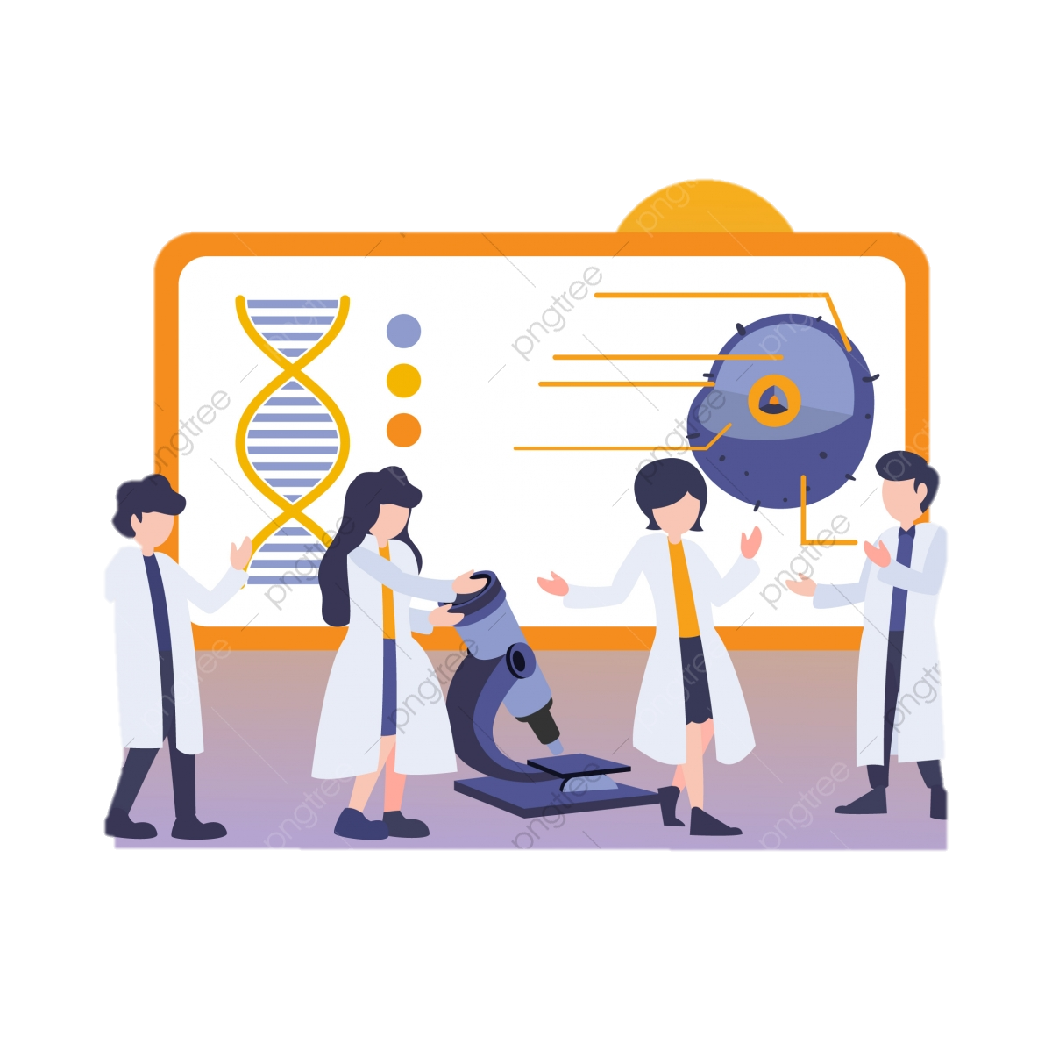
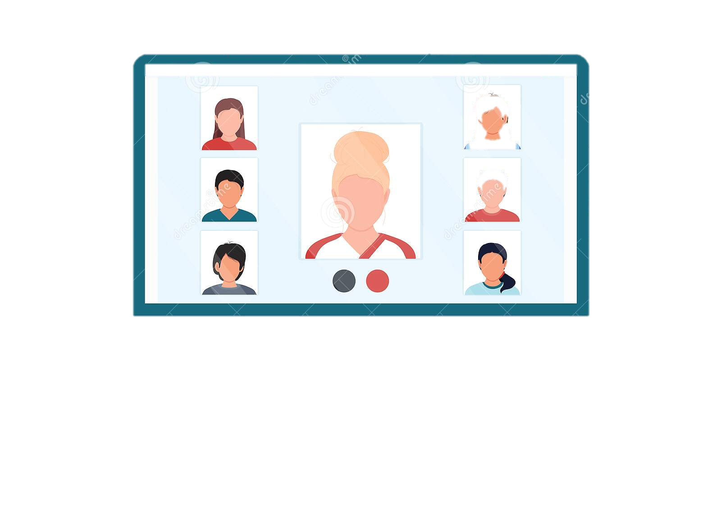


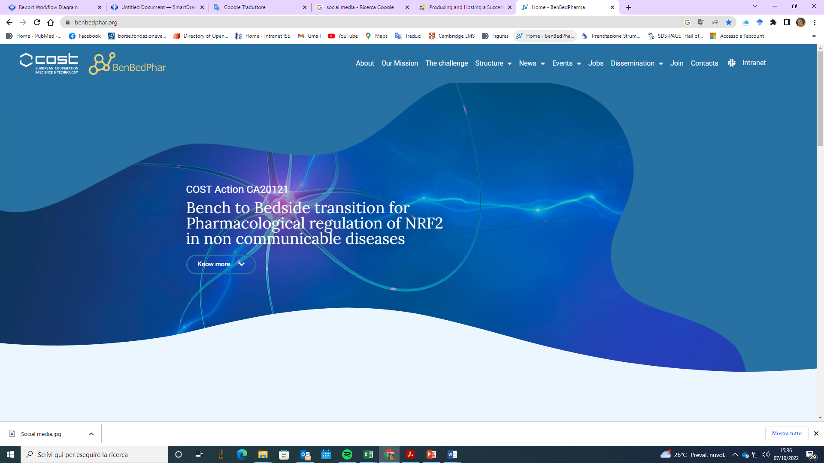
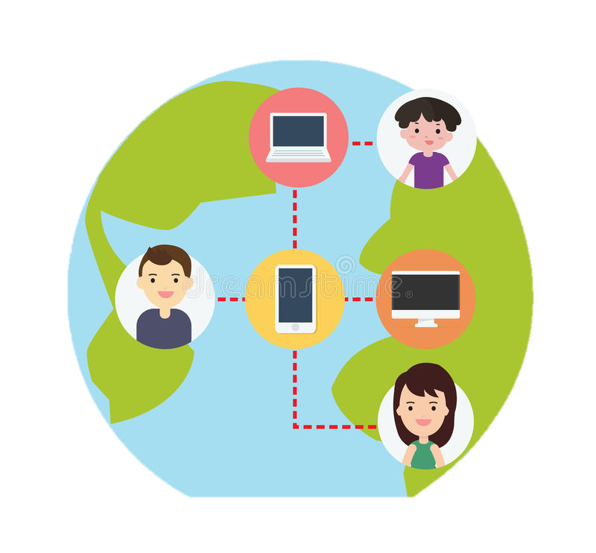
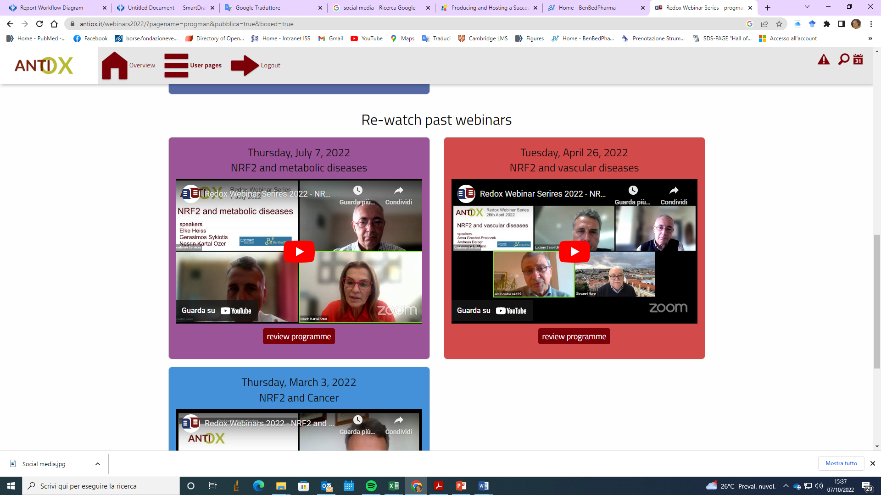

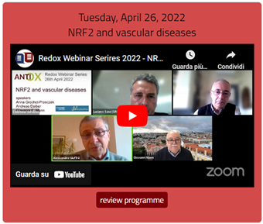
Flow chart for a webinar production
Suggested topics and speakers by WG leaders and/or members
Prep meeting with speakers and organizers.
Planning of titles, date and biosketches
Webinar created on the antiox.it platform
Posted on BenBedPharm
Partecipant registration on antiox.it
Webinar promotional campaign
Re-watch past
webinars on antiox.it
Global webinar event
Notes:
Webinars are one of the main tasks reported for WG5 for promoting NRF2-related medicine to the scientific community and lay audiences. Webinar represents a successful tool to disseminate knowledge in EU-funded projects. PRODUCING AND HOSTING A SUCCESSFUL WEBINAR, it doesn't have to be difficult but it requires that few simple steps have to make for a successful event. For a webinar production the topic, the speakers and the date have been scheduled in time. Moreover, a Plan B has been made in case a speaker gets sick or a producer has a family emergency.

Slide 6

Welcome Redox Webinar Series
A typical session feature three presenters, each allotted 25 minutes of time
A Q & A 30 minutes of time at the end of the session to discuss specific issues.
Attendees may send questions via the webinar chat or by voice
Recorded webinars are always available on website https://www.antiox.it/
Participation is free of charge but registration is compulsory at www.antiox.it

Slide 7
first webinar: NRF2 and Cancer March 3rd, 2022
NRF2 Addiction and Transcriptional Regulation in Cancer Hozumi Motohashi, Tohoku University, Japan.
The intricacies of NRF2 in Cancer Donna Zhang, University of Arizona, USA.
NRF2 and cysteine metabolism in cancer Gina DeNicola, Department of Cancer Physiology at Moffitt Cancer Center in Tampa, Florida, USA

Slide 8
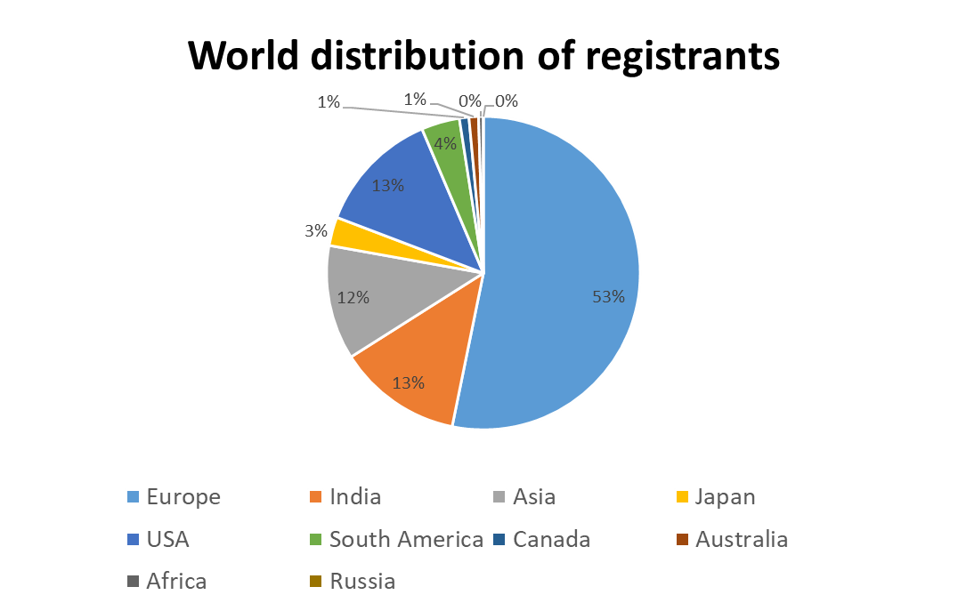
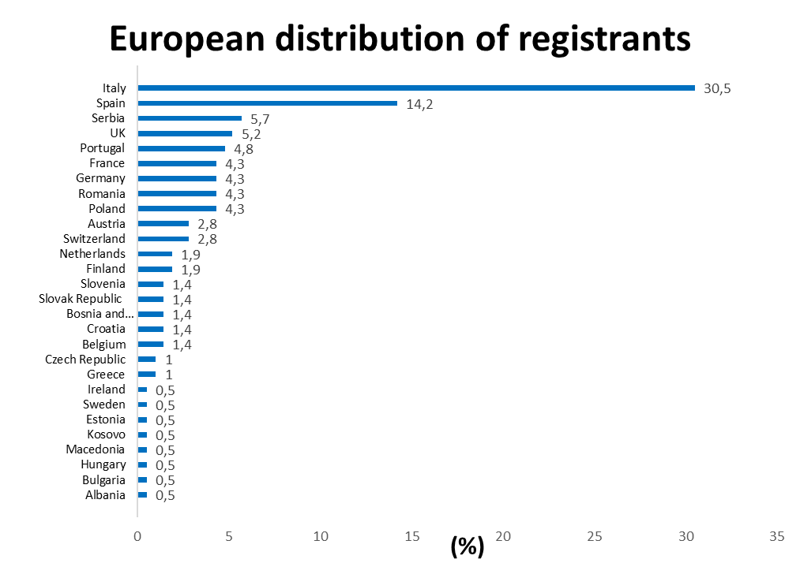
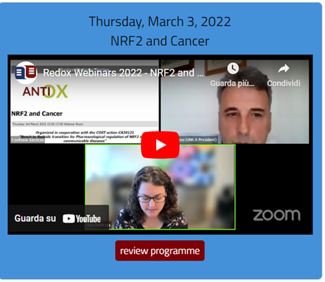
1. NRF2 and Cancer: 383 registrations, about 210 participants and worldwide participants
N = 383
N =210
*
* Turkey = 23

Slide 9
Second webinar: NRF2 and vascular diseases April 26th, 2022
Novel atypical functions of Nrf2 and Keap1 in endothelial cells, by Anna Grochot-Przeczek. Department of Medical Biotechnology, Faculty of Biochemistry, Biophysics and Biotechnology, Jagiellonian University, Krakow, Poland
The NRF2-KEAP1 signaling pathway as a pharmacological target in cardiovascular and neuropsychiatric complications in response to environmental risk factors traffic noise and particulate matter, by Andreas Daiber. Department of Cardiology 1, Laboratory of Molecular Cardiology, University Medical Center of the Johannes Gutenberg University, Mainz, Germany
Transcriptional Activation of NRF2 Defense Genes is Attenuated in Vascular Cells under Physiological Normoxia: Consequences for Reperfusion Injury, by Giovanni E. Mann. British Heart Foundation Centre of Research Excellence, Faculty of Life Sciences & Medicine, King’s College London, London SE1 9NH, U.K.

Slide 10

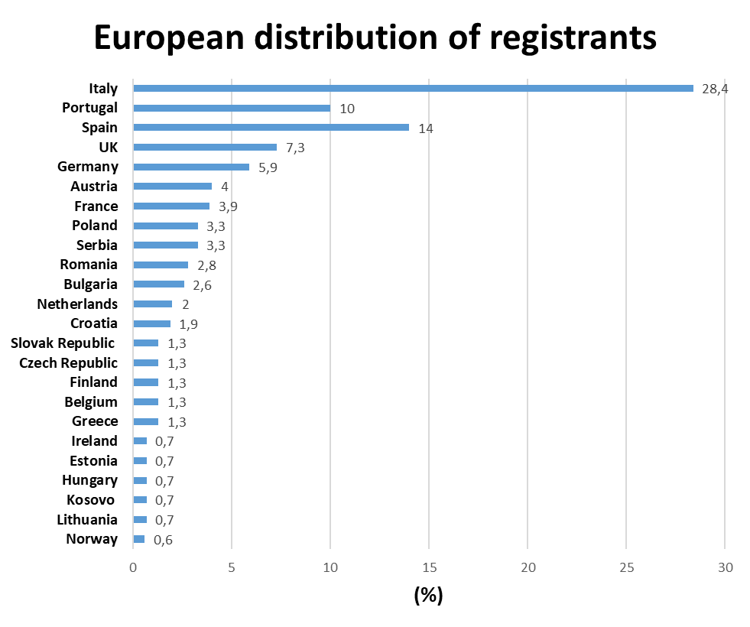
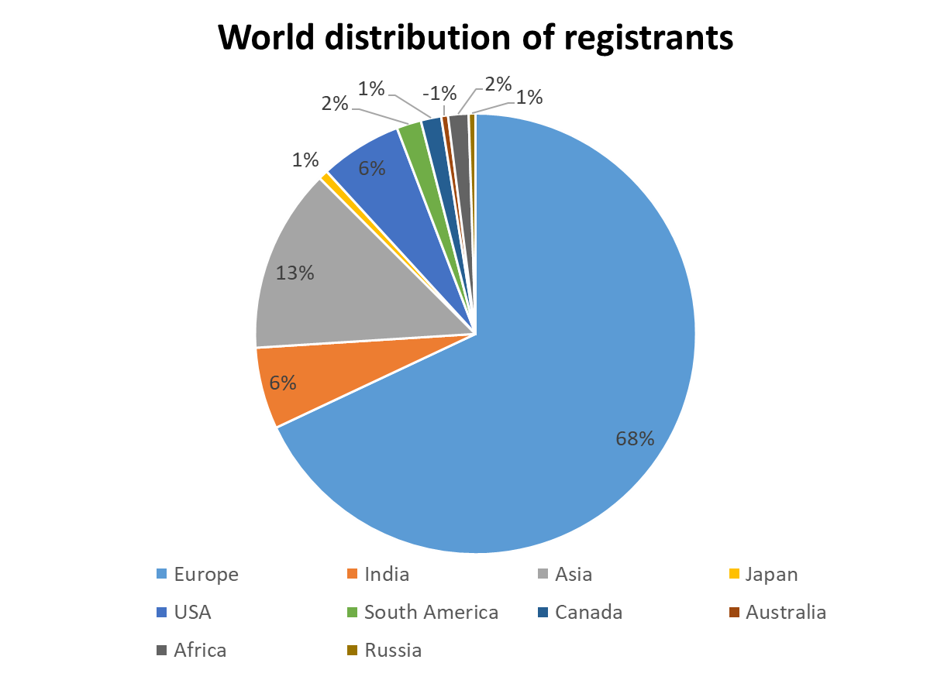
2. NRF2 and vascular diseases: 268 registrations, about 100 participants and worldwide participants
N =268
N =151
*
* Turkey = 23

Slide 11
Third webinar: NRF2 and metabolic diseases July 7th, 2022
AMP(K)lifying Nrf2: The crosstalk between Nrf2 and the metabolic master hub AMPK, by Elke H Heiss. Department of Pharmacognosy, University of Vienna, Vienna, Austria.
Translational implications of Nrf2 signaling in the thyroid, by Gerasimos Sykiotis (Gerry) Faculty of Biology and Medicine, University of Lausanne, 1011 Lausanne, Switzerland.
Cholesterol Mediated Nrf2 Status in NASH Development: Role of α-Tocopherol, by Nesrin Kartal Ozer. Department of Biochemistry, Faculty of Medicine, Marmara University, Maltepe, Istanbul, Turkey.

Slide 12
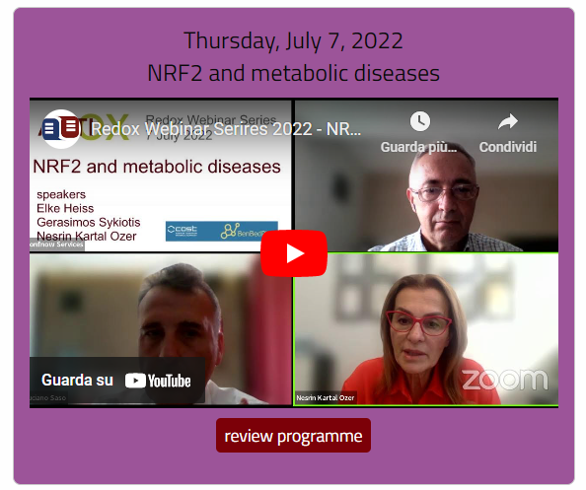
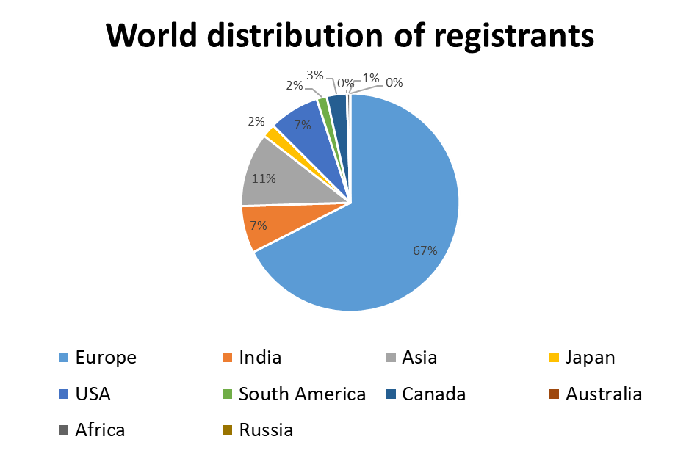
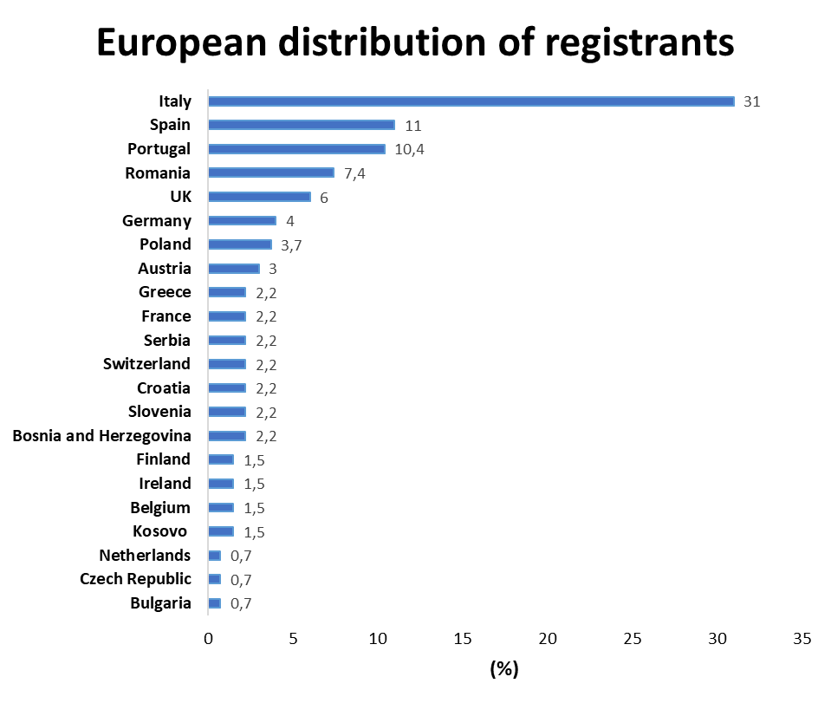
3. NRF2 and metabolic diseases: 200 registrations, about 182 participants and worldwide participants
N =200
N =135
*
* Turkey = 20

Slide 13
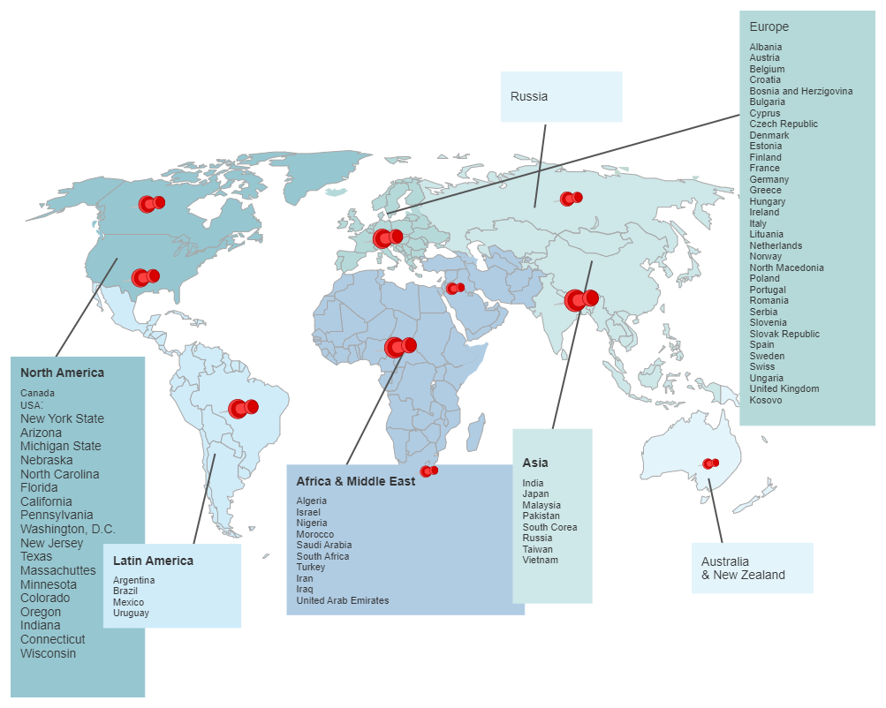
Our global community: 70 countries participating in Redox Webinar series

Slide 14
Conclusions
BenBedPhar webinar
is an on line tool to support Open Science
promotes spark learning and conversation among science communities
connects to a global audience unrestrained by travel or logistical barriers
on-demand webinar format can also serve as persistent promotional content on BenBedPhar website and social media

Slide 15
Current plans and To-do list
Prepare a list for all members that have been invited to participate as speakers
Prepare a list for speakers who should agree to participate at next webinars and possibly sharing the tentative titles with all WG members. This would enhance interest in participation.

Slide 16

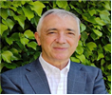
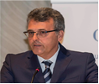
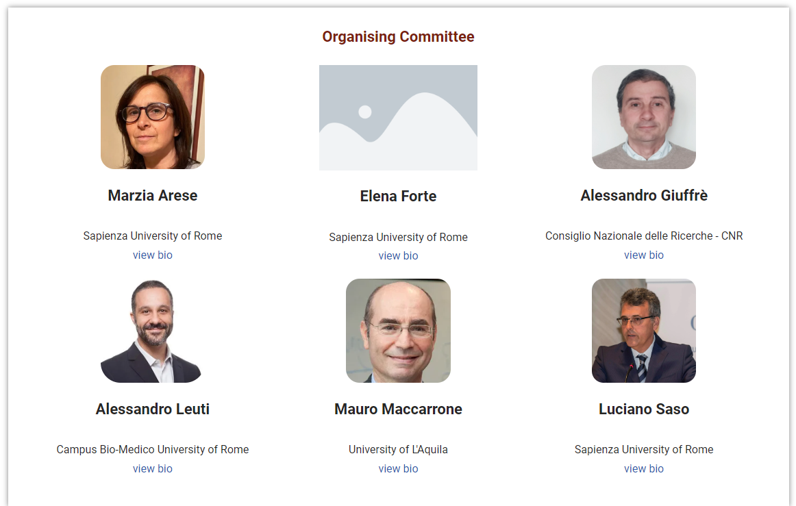
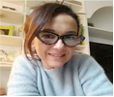
CONTACTS For information concerning our Webinars
info@antiox.it
https://antiox.it/
https://benbedphar.org/
For scientific information
ANTONIO CUADRADO
Action Chair BenBedPhar
UNIVERSIDAD AUTÓNOMA DE MADRID, SPAIN
antonio.cuadrado@uam.es
LUCIANO SASO
ANTIox Redox Webinar Series organizer
SAPIENZA UNIVERSITY OF ROME, ITALY
luciano.saso@uniroma1.it
BRIGITTA BUTTARI
WG5 Leader BenBedPhar
ISTITUTO SUPERIORE DI SANITA’, ROME, ITALY
brigitta.buttari@iss.it

